Slide 1
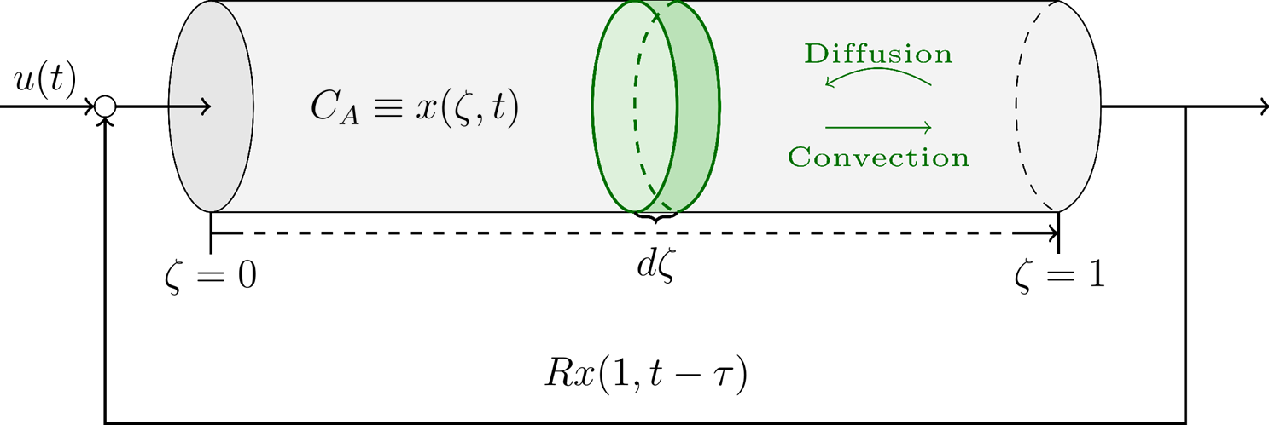
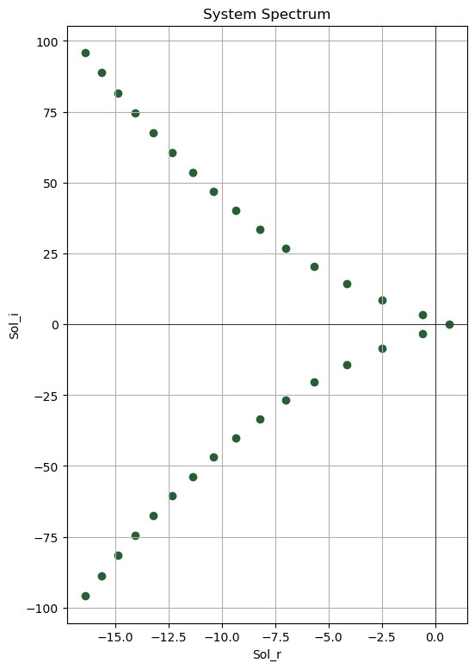
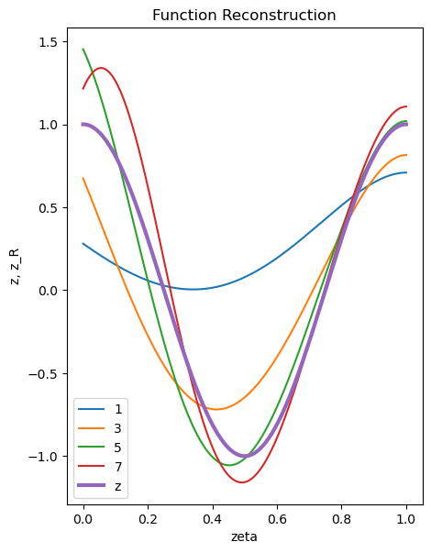
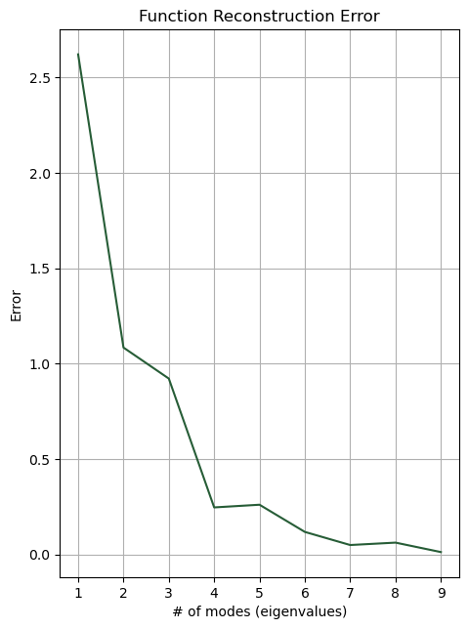
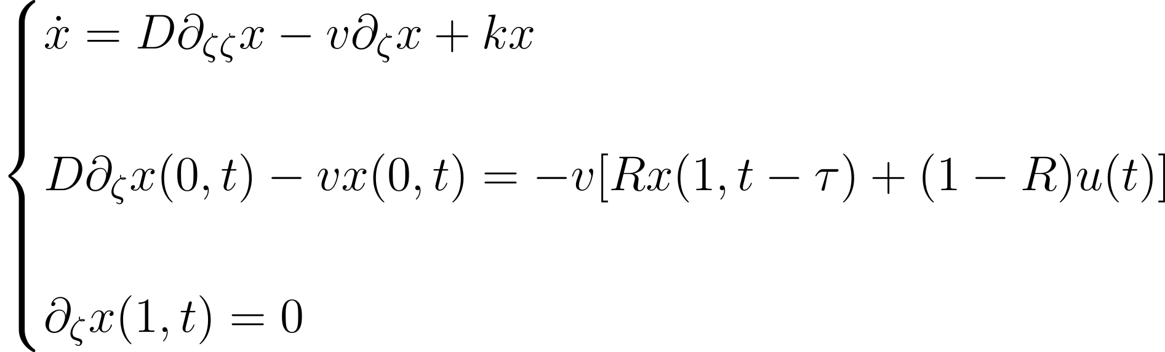
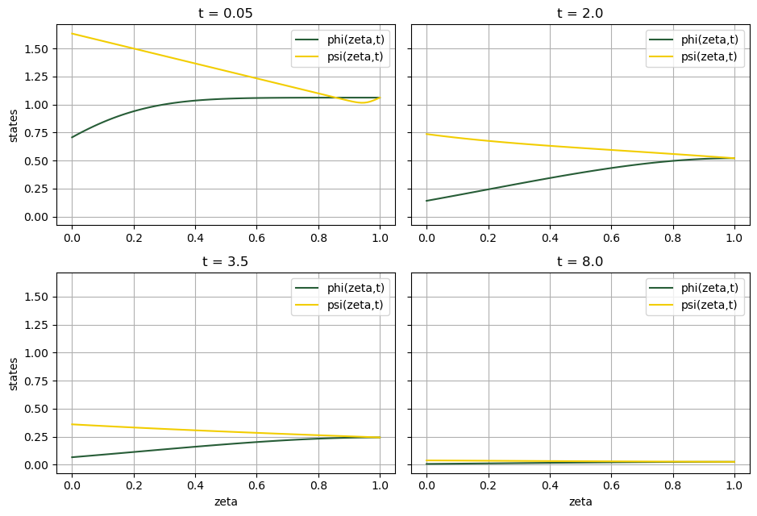
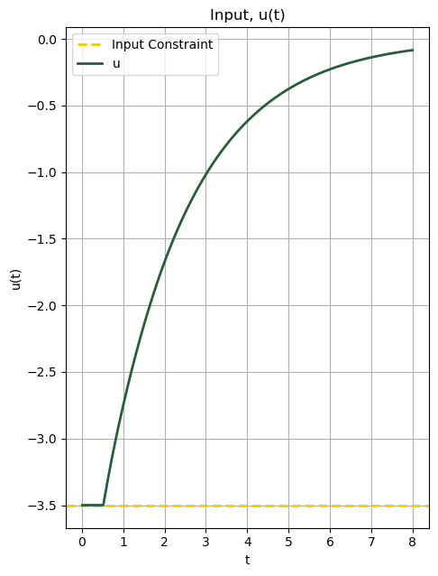
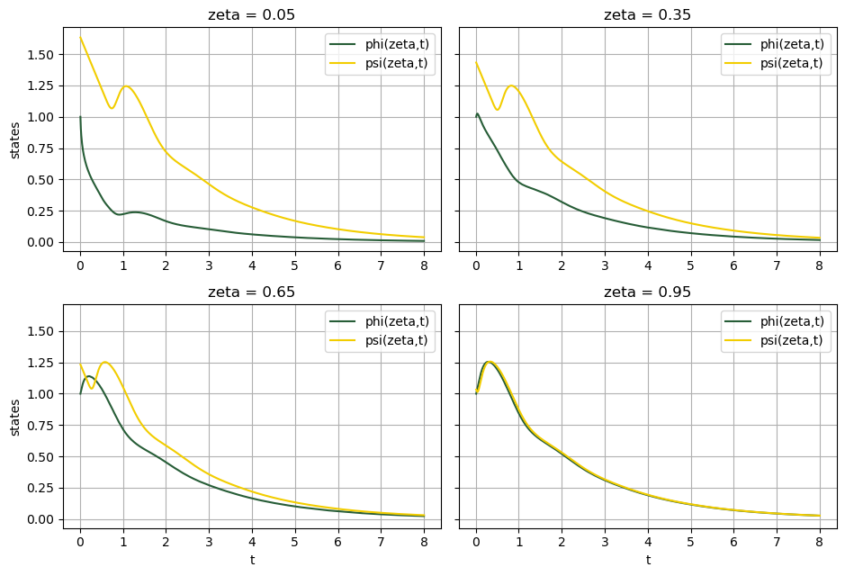
MPC of an Axial Dispersion Tubular Reactor with Delayed Recycle
Behrad Moadeli¹, Guilherme Ozorio Cassol¹, Stevan Dubljevic¹
¹Department of Chemical and Materials Engineering, University of Alberta, Edmonton AB, Canada
Introduction
Open Loop System Model
Distributed Parameter Systems
Distributed Parameter Systems involve spatially varying parameters, typically described by Partial Differential Equations (PDEs). These systems have an infinite-dimensional state-space representation, making controller design challenging. To tackle this complexity, two approaches are commonly employed: Early lumping, which is less complex, and late lumping, which, despite its complexity, offers superior solutions. [1]
Infinite-dimensional System Modeling Procedure
To model the open-loop system, we follow the following steps: [3]
Solving the Eigenvalue Problem
Determining the Adjoint Operator
Finding the Characteristic Equation
Analyzing the Eigenvalue Distribution (Spectrum Analysis),
Exploring Eigenfunctions as the bi-orthogonal basis to the function-space
Identifying Dominant Modes
These steps help us understand the system's intrinsic properties.
Late Lumping vs. Early Lumping
The system is modeled using the Late Lumping approach; in which the system is approximated with a finite number of eigenvalue-eigenfunction pairs, allowing us to reduce the infinite-dimensional system to an accurate enough finite-dimensional approximation while retaining its essential properties.
This contrasts with the Early Lumping method, in which the system is discretized in space to form a finite system of ODEs; potentially leading to a loss of critical system dynamics, such as stability. [4]
Axial Dispersion Tubular Reactors with Delayed Recycle
In chemical, petrochemical, and other process industries, axial dispersion tubular reactors with delayed recycle are among the most prevalent types of unit operations. A second-order parabolic PDE is used to model the reactor, as the result of encountering diffusive terms, convective terms, and generation/consumption terms. [2] In contrast, the recycle section is described by a first-order hyperbolic PDE, involving pure transport. In most of the cases, the recycle flow takes some time to travel from the reactor's end to its head, which is analogous to the notion of delay; [3] hence the title ‘Delayed Recycle’. The state of the system, in both cases, pertains to be concentration.
Model Predictive Controller (MPC)
Model Predictive Control
Following time discretization, a constrained Quadratic Linear Optimization Problem (QLP) is employed to minimize a cost function under input, state, and stability constraints. [2,5]
Observing the system's input response affirms stability and constraint adherence.
References
Harmon Ray, W. (1980) Advanced Process Control. New York, NY: McGraw-Hill.
Khatibi, S., Ozorio Cassol, G. and Dubljevic, S. (2021) “Model predictive control of a non-isothermal axial dispersion tubular reactor with recycle,” Computers & chemical engineering, 145(107159), p. 107159.
Curtain, R. and Zwart, H. (2020) Introduction to infinite-dimensional systems theory: a state-space approach. Springer Nature.
Moghadam, A. et al. (2013) “Boundary optimal (LQ) control of coupled hyperbolic PDEs and ODEs,” Automatica, 49(2), pp. 526–533.
Xu, Q. and Dubljevic, S. (2017) “Linear model predictive control for transport‐reaction processes,” AIChE journal. American Institute of Chemical Engineers, 63(7), pp. 2644–2659. doi: 10.1002/aic.15592.

